Slide 1

CSE 310 PROGRAMMING IN JAVA

Slide 2
Using the Java API Docs

Slide 3
Using the Java API Docs
The JAVA API (Application Programming Interface) is a library of functions and classes that Java provides to the user. It provides a list of objects and or classes available for the programmer, with examples and descriptions, as well as a list of the included methods for each class.
The Java API documentation is a valuable asset for programmers wishing to construct programs and software in the JAVA programming language.
The Java API Documentation for the JAVA Platform SE (Standard Edition) 7 can be located online on the oracle website at:
http://docs.oracle.com/javase/8/docs/api/

Slide 4
Using the Java API Docs
You can also download complete Java API Documentation for offline use.
After the download has completed, extract the zip file then copy the docs folder to the JDK directory.
(Example: C:\..\Java\jdk1.7.0_05\)
Open index.html from the docs folder to launch the Java API Documentation on your Internet Browser. Click the Java SE API link to navigate to the API documentation section.
Alternatively, you can launch the index.html file located in the docs/api folder.

Slide 5

Using the Java API Docs
The API documentation is organized into three separate containers or windows. The main larger window on the right shows the current content being viewed.
The upper left window/container lists the Packages that are included in the JAVA SE8 edition.
The lower left window/container lists all the classes included in the JAVA SE7 edition.
Clicking the help link on the top menu of the main window gives the user a detailed insight into how the documentation is organized.

Slide 6
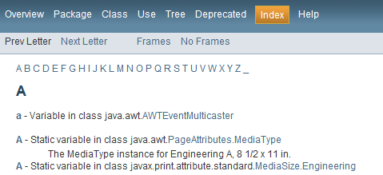
Using the Java API Docs
The index link provides a comprehensive index of the entire documentation, with hyperlinks to each letter at the top.

Slide 7
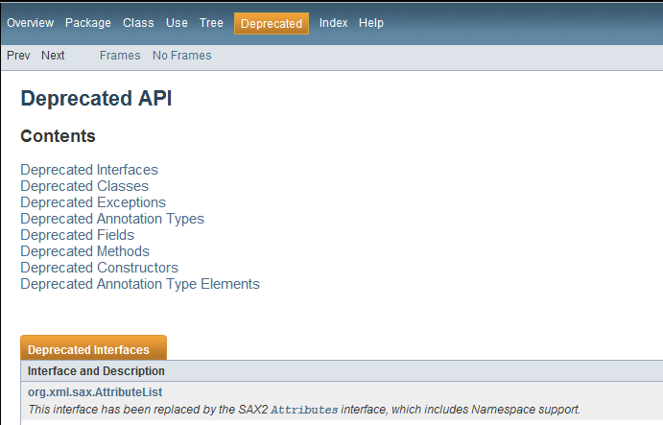
Using the Java API Docs
The Deprecated link provides a list of Interfaces, Classes, Exceptions, etc., that have been superseded and should be avoided. In the description of each deprecated item contains link(s) to replacement, if one exists.

Slide 8
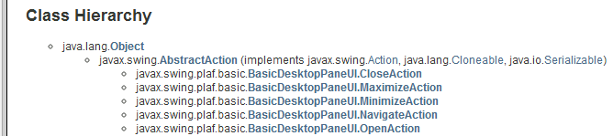
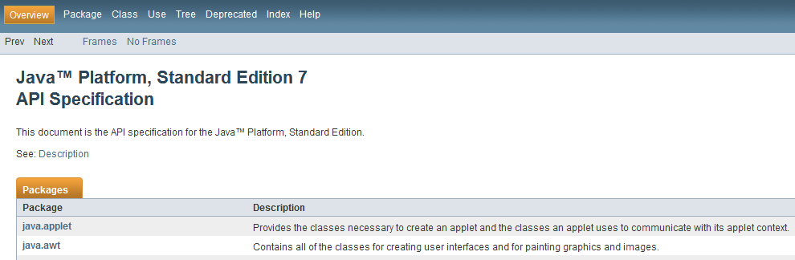
Using the Java API Docs
The Tree link provides a hierarchical view of all the classes and or packages included in the Java SE8 release.
The overview section provides a brief description for each package.

